Slide 1


Slide 2
DEEP LEARNING COURSE
FALL 2026
Usman Khan, PhD

Slide 3
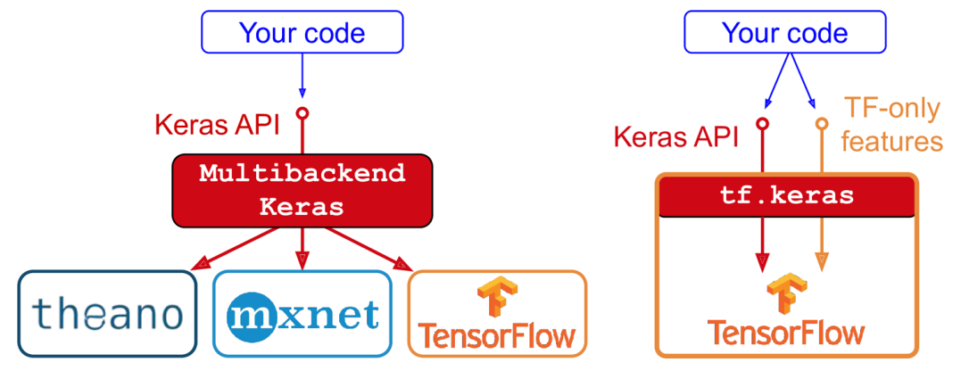
IMPLEMENTING MLP WITH KERAS
Keras is a high-level Deep Learning API that allows you to easily build, train, evaluate, and execute all sorts of neural networks. Its documentation (or specification) is available at https://keras.io/. The reference implementation, also called Keras, was developed by François Chollet as part of a research project and was released as an open source project in March 2015
You can choose from three popular open-source Deep Learning libraries: TensorFlow, Microsoft Cognitive Toolkit (CNTK), and Theano
Since late 2016, other implementations have been released. You can now run Keras on Apache MXNet, Apple’s Core ML, JavaScript or TypeScript (to run Keras code in a web browser), and PlaidML (which can run on all sorts of GPU devices, not just Nvidia).

Slide 4
IMPLEMENTING MLP WITH KERAS
TensorFlow itself now comes bundled with its own Keras implementation, tf.keras. It only supports TensorFlow as the backend, but it has the advantage of offering some very useful extra features e.g TensorFlow’s Data API, which makes it easy to load and preprocess data efficiently.
The most popular Deep Learning library, after Keras and TensorFlow, is Facebook’s PyTorch library. The good news is that its API is quite similar to Keras’s (in part because both APIs were inspired by Scikit-Learn and Chainer), so once you know Keras, it is not difficult to switch to PyTorch.
TensorFlow 2 is arguably just as simple as PyTorch, as it has adopted Keras as its official high-level API and its developers have greatly simplified and cleaned up the rest of the API. The documentation has also been completely reorganized, and it is much easier to find what you need now.

Slide 5
IMPLEMENTING MLP WITH KERAS
Steps to Install Wsl in Windows (connected to Internet):-
Open Command Prompt on Windows 11 or 10 and type wsl –install (To Install Ubuntu)
Restart the computer to install the Linux
Open the Ubuntu Terminal and run command sudo apt update && sudo apt upgrade
Then run the command sudo apt install python3 python3-pip python3-venv
Create a Directory DL_Projects by linux command mkdir DL_Projects and then cd DL_Projects
Optional Step : Create a new environment python3 –m venv .venv and then source .venv/bin/activate
pip install numpy tensorflow scikitlearn

Slide 6
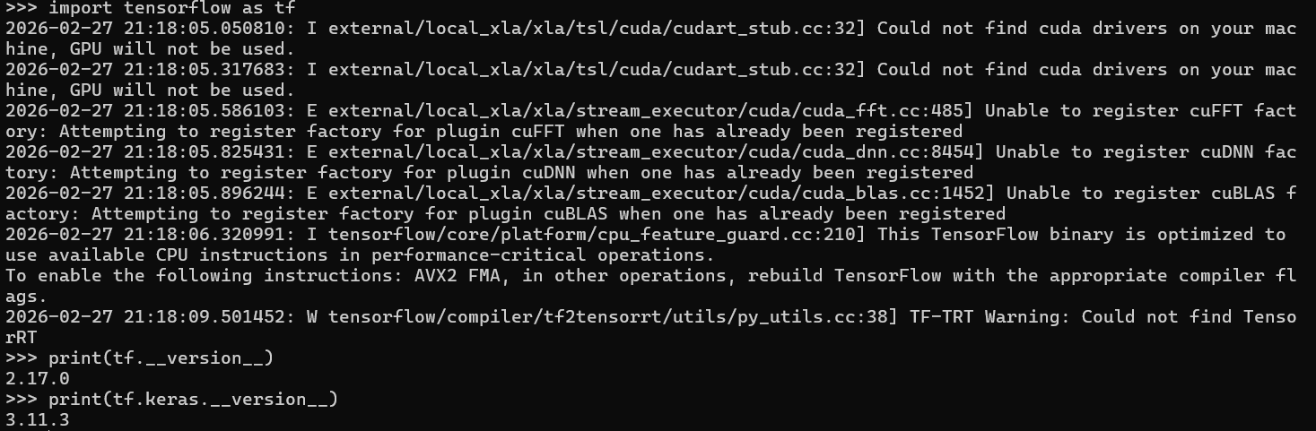
IMPLEMENTING MLP WITH KERAS

Slide 7
TENSORFLOW OPS BASICS
import tensorflow as tf
## Example of constants
a = tf.constant(2)
b = tf.constant(3)
x = tf.add(a,b)
print(x.numpy())
# tf.constant(value, dtype=None, shape=None, name='const', verify_shape=False)
# Constant of 1 d
a = tf.constant([2,2], name= "vector")
# Constant 2 x 2 tensor
b = tf.constant([[0,1],[2,3]],name="matrix")
# Creating a Zero Tensor
# tf.zeros(shape, dtype=tf.float32, name=None)
tf.zeros([2,3], dtype=tf.int32)
# Creating zeros like tensor
#tf.zeros_like(input_tensor, dtype=None, name=None, optimize=True)
input_tensor= [[0,1],[2,3],[4,5]]
tf.zeros_like(input_tensor)
# tf.ones(shape, dtype=tf.float32, name=None)
tf.ones([2,3], dtype=tf.int32)
tf.ones_like(input_tensor)
# Create a tensor filled with scalar values
# tf.fill(dims, value, name=None)
tf.fill([2,3], 8)
# Creating Linespace
#tf.linspace(start,stop, num, name=None)
linespace = tf.linspace(start=1.0, stop=5.0, num=10)
print(linespace)

Slide 8
TENSORFLOW OPS BASICS
import tensorflow as tf
import numpy as np
from pprint import pprint
matrix = tf.constant(np.array([[1,2],[3,4]]), dtype=tf.float32, name='matrix')
vector = tf.constant(list(range(1,4)), dtype=tf.float32, name='vector')
scalar = tf.constant(42.0, dtype= tf.float32, name='scalar')
pprint([scalar, vector, matrix])
## casting the tensor to different dtype
scalar_int = tf.cast(scalar, dtype=tf.int16)
print(scalar)

Slide 9
TENSORFLOW OPS BASICS
## ==== Linear Regression in Tensorflow === ##
## This is Lab 2 for the Course DSSC-3. It can be part of exam ##
import tensorflow as tf
tf.random.set_seed(777)
# X & Y Data
x_train = tf.constant(list(range(1,10)),dtype=tf.float32, name='x_train')
y_train = tf.add(x_train,x_train,name='y_train')
print(x_train)
# We try to find the values of W & b to compute
# y_data = x_data * W + b
W = tf.Variable(tf.random.normal([1],dtype=tf.float32), name='weight')
b = tf.Variable(tf.random.normal([1],dtype=tf.float32), name='bias')
# Define the Learning Rate
learning_rate = 0.001

Slide 10
TENSORFLOW OPS BASICS
for step in range(2001):
with tf.GradientTape() as tape:
# Our Hypothesis is h = X*W + b
hypothesis = x_train * W + b
# cost / loss function
cost = tf.reduce_mean(tf.square(hypothesis - y_train))
# Lets Compute the Gradients of the Cost Function
# with respect to the weight and bias vectors
gradients = tape.gradient(cost,[W,b])
dw = gradients[0]
db = gradients[1]
# Update the variables
W.assign_sub(learning_rate*dw)
b.assign_sub(learning_rate*db)
if step%20 == 0:
print(f"step{step}, cost {cost.numpy()}, weight {W.numpy()}, bias {b.numpy()}")

